Slide 1
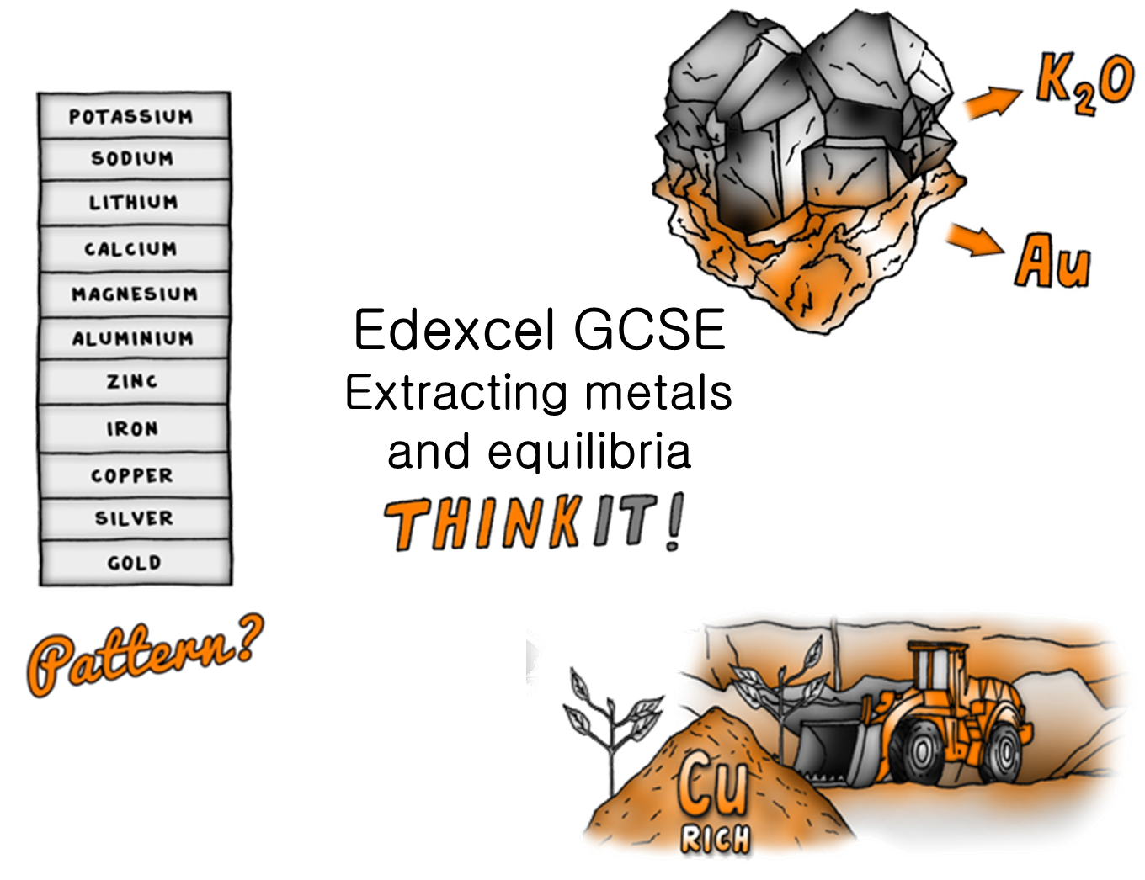
© Copyright The PiXL Club Ltd, 2017

Slide 2
Metal Oxides and Extraction:
Explain why gold is found as a metal element rather than combined with any other elements in a compound.
The reaction between aluminium powder and iron(III) oxide is used in the rail industry. Explain the reaction using a word and symbol equation.
Explain why carbon can reduce tin oxide but not magnesium oxide.
Alternative methods of extracting metals (HT only):
Describe and explain the difference between phytomining and bioleaching.
Explain why phytomining and bioleaching need to be used.
Evaluate the use of phytomining and bioleaching over traditional extraction methods.
:
The effect of changing concentration on equilibrium (HT Only)
Use Le Chatelier’s principle to explain what affect increasing the concentration of a product will have on an equilibrium.
What would happen to the concentration of the reactants if we halved the concentration of the products?
The Reactivity Series:
Li + H₂0 and Zn + HCl produce similar products. State what these are and explain why they are produced and what you would observe.
Explain why gold and silver are used to make jewellery and why potassium is stored in jars of oil.
Describe a safe method that could be used to put metals in order of their reactivity according to their reactions with hydrochloric acid.
The effect of changing temperature on equilibrium (HT Only)
A system is in equilibrium giving the reaction
If the forward reaction is endothermic,
explain what will happen to the system
if the temperature of the system is
increased and why this happens.
Edexcel GCSE
Extracting metals and equilibria
ThinkIT!
© Copyright The PiXL Club Ltd, 2017
Life cycle assessment and ways of reducing the use of resources:
Explain differences in the stages of the life cycle assessment for plastic and paper shopping bags.
Explain differences and similarities of the recycling of aluminium and glass.
In 2015 a 5p charge had to be charged for single use carrier bags. Discuss the implications of this.
The Haber process:
Write a balanced symbol equation for the reversible reaction when nitrogen gas reacts with hydrogen gas to make ammonia gas.
What would you need to do to ensure that the above reaction could reach equilibrium?
Explain why the Haber process uses 450⁰C and 200 atmospheres
The effect of changing pressure on equilibrium (HT Only)
In the equilibrium below, what will happen to the position of equilibrium if the pressure in the system is halved?

